Slide 1
Pi-Rate Radio
Claymore & WillNett

Slide 2

What is it?
Several versions of the Raspberry Pi can be utilized to broadcast RF signals between 1MHz – 300MHz. This includes the following:
Some AM Radio
FM Broadcast Radio
Aviation Communications & Navigation (VOR / DME / COMM)
Marine Communication & Navigation
Amature Radio (Ham)
Differential GPS (Not standard GPS)
Wireless Microphones (Peter Popoff?)

Slide 3
Technical Summary:
The Pi has an onboard clock which can be oscillated to run at certain frequencies.
Using Python which calls a C library which is provided by the git project, it maps the bus and in physical memory into virtual address space setting the clock generator module enabling output to GPIO pin #4.
By attaching a simple wire to GPIO Pin #4 it is the only additional hardware needed for broadcasting.
A ~30” wire broadcasting in FM Radio Band (88Mhz – 108Mhz) can broadcast up to the length of a football field.
Some hams claim broadcast can go up to ~1GHz (CW Only)

Slide 4
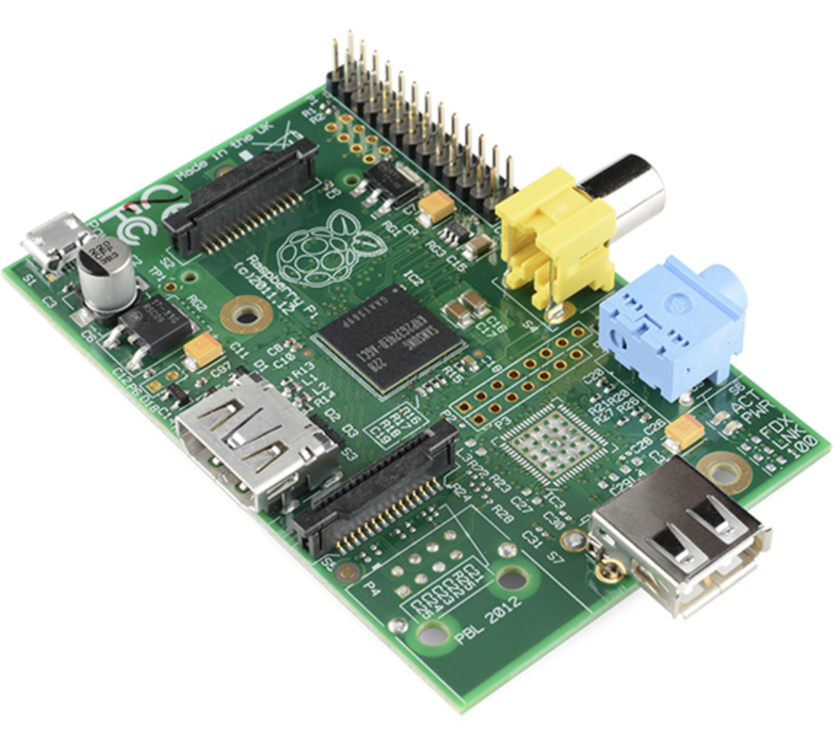
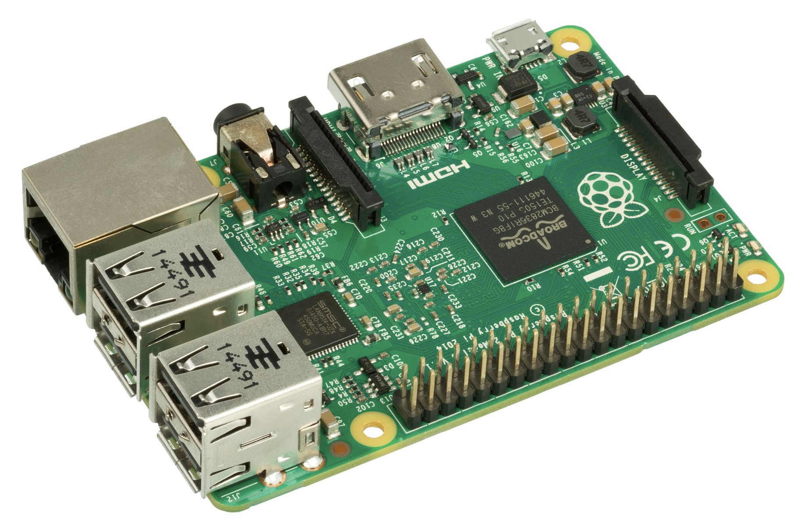
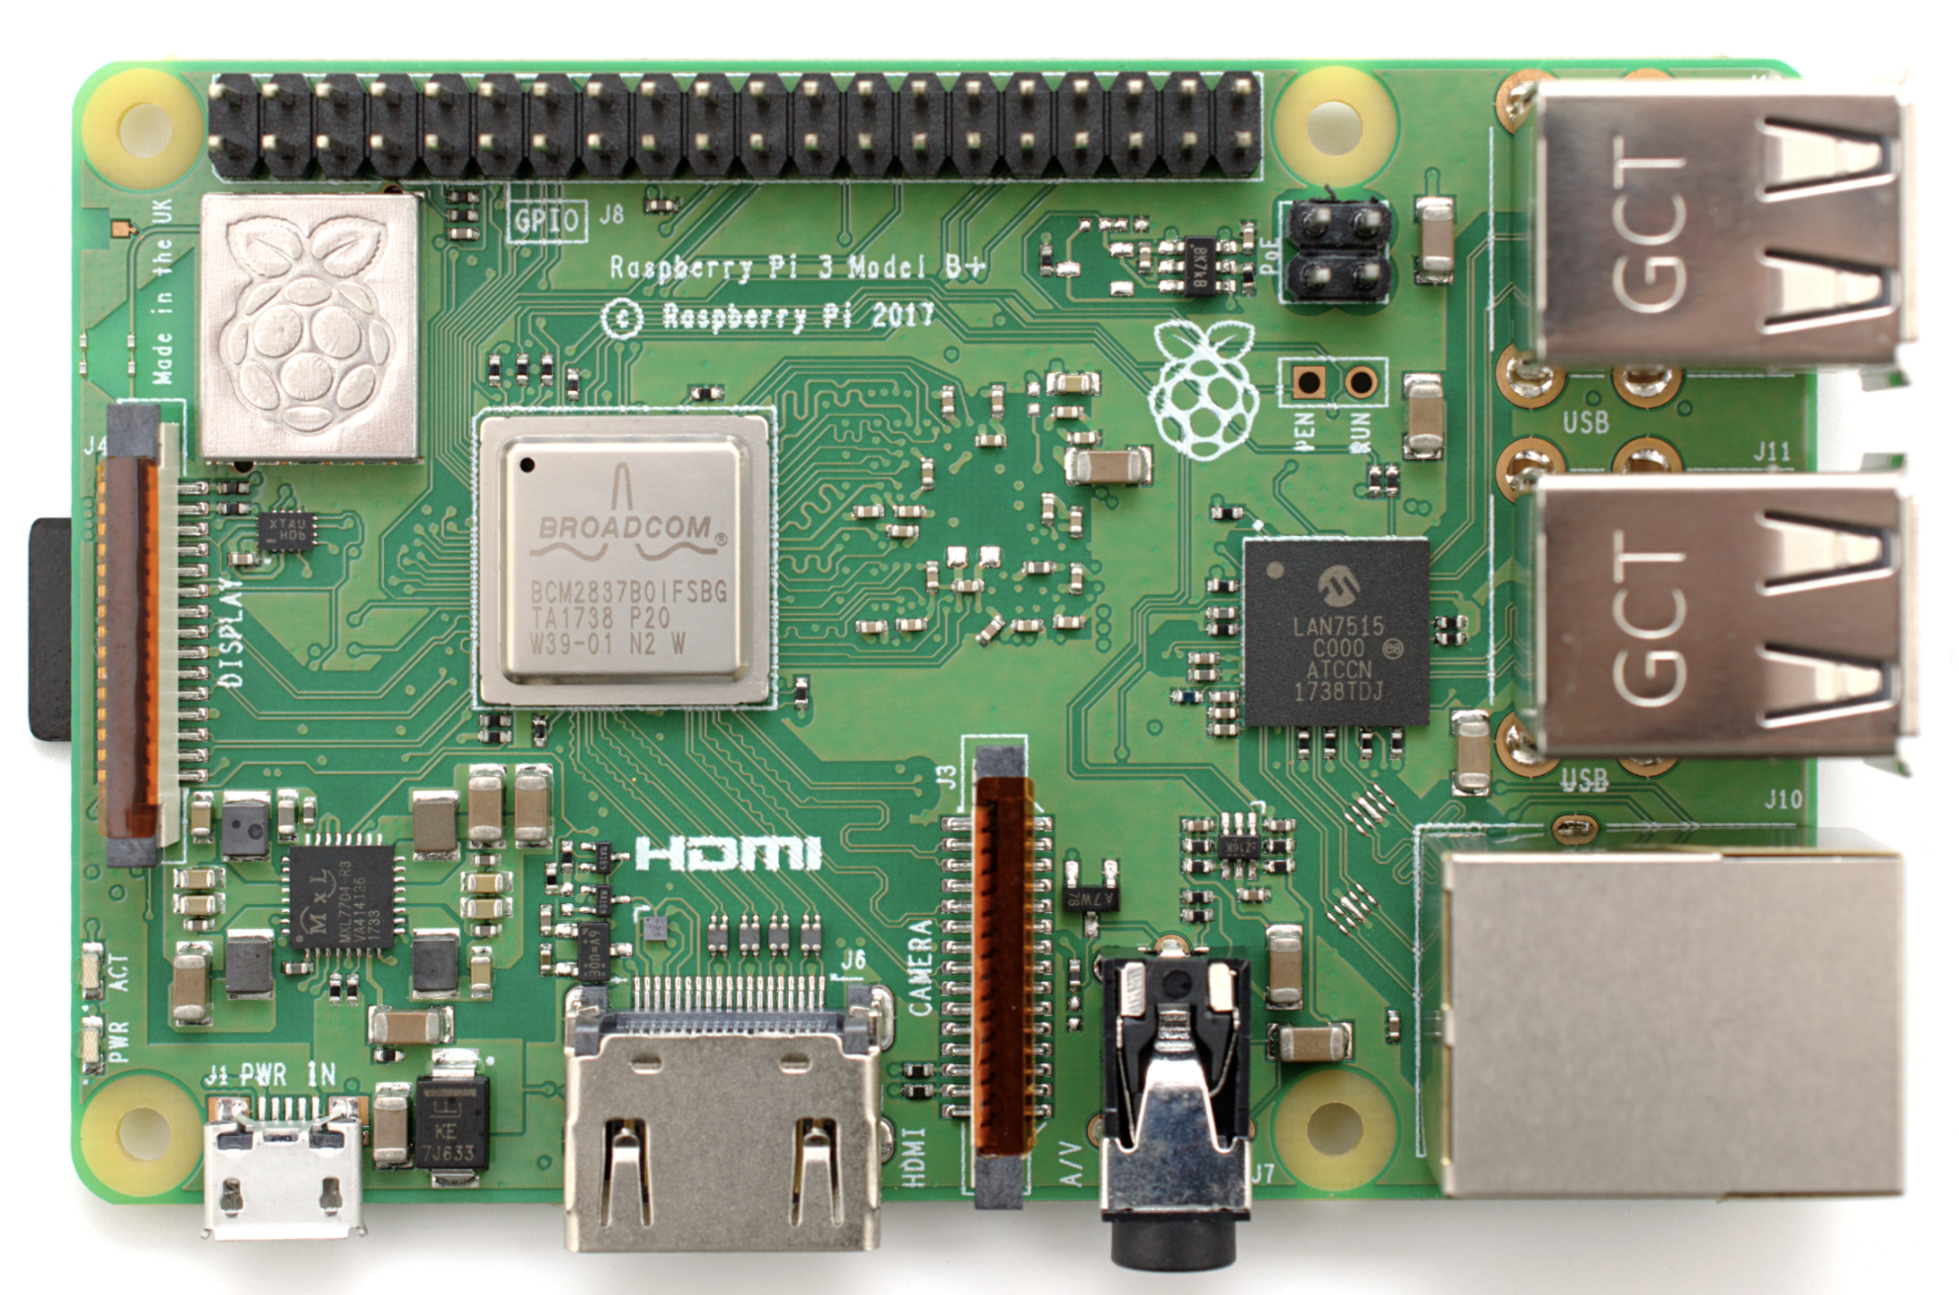
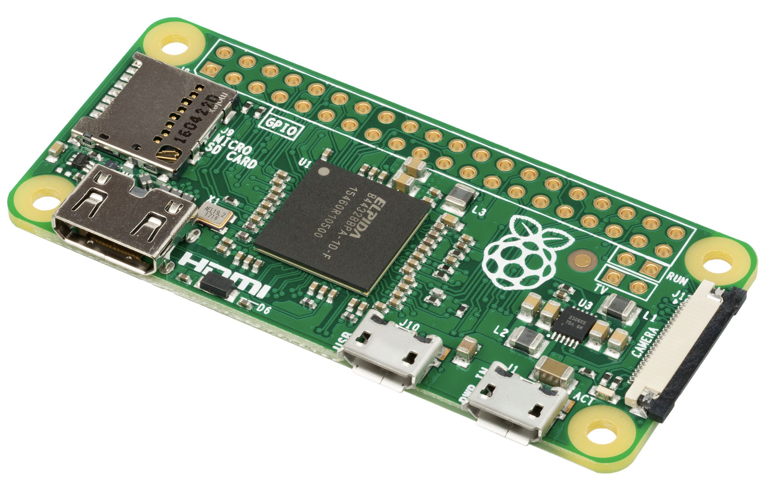
Works on the following Raspberry Pi’s
Rasperry Pi 1 Raspberry Pi2 Raspberry Pi3
And of course…
The Raspberry Pi Zero & ZeroW

Slide 5
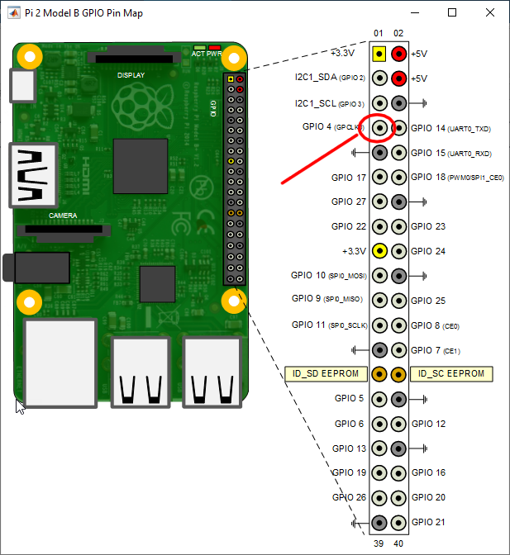
Add wire to the following pin:

Slide 6
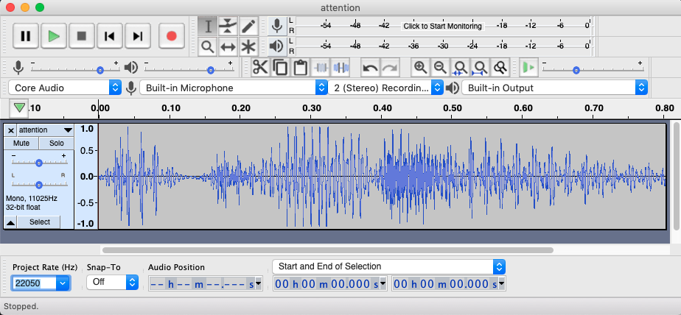
For best results…
Make your audio files using an Audio application like audacity.
Resample your audio file to 22050 Hz wav then save it.
Use unshielded wire.
Cable length will vary depending on frequency desired.
Do NOT leave continuously playing! FCC does not like that.

Slide 7

Real world malicious application… “Hackers” broadcasted to an Air Traffic Control Tower on the Aviation Emergency Frequency announcing a potential threat.

Slide 8
References / Links
Software: https://github.com/rm-hull/pifm
https://abcnews.go.com/US/story?id=95993&page=1
Frequency List: https://www.rfcafe.com/references/electrical/rf-freq-allo-us.htm

Slide 9
Questions?

